Slide 1

Autonomous
Robot Waiters
GROUP 12 – Final Progress

Slide 2
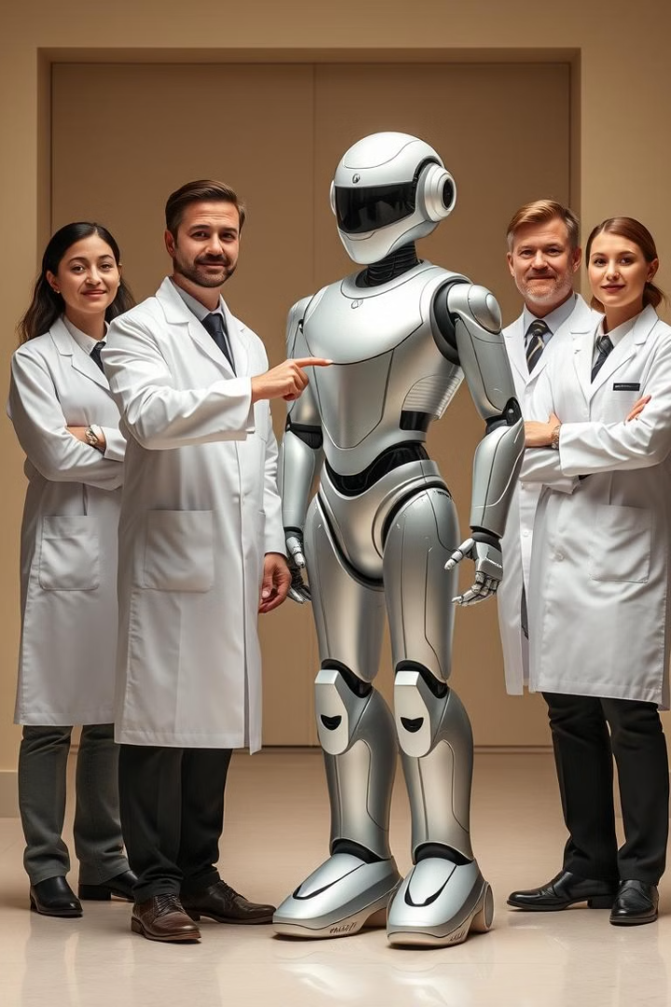

Our team
Supun Wickrama – KAHDSE24.2F- 048
Chamudhitha Pemarathna - KAHDSE24.2F- 035
Lakith Abeywarna - KAHDSE24.2F- 036
Jalani Samarakoon - KAHDSE24.2F- 031

Slide 3
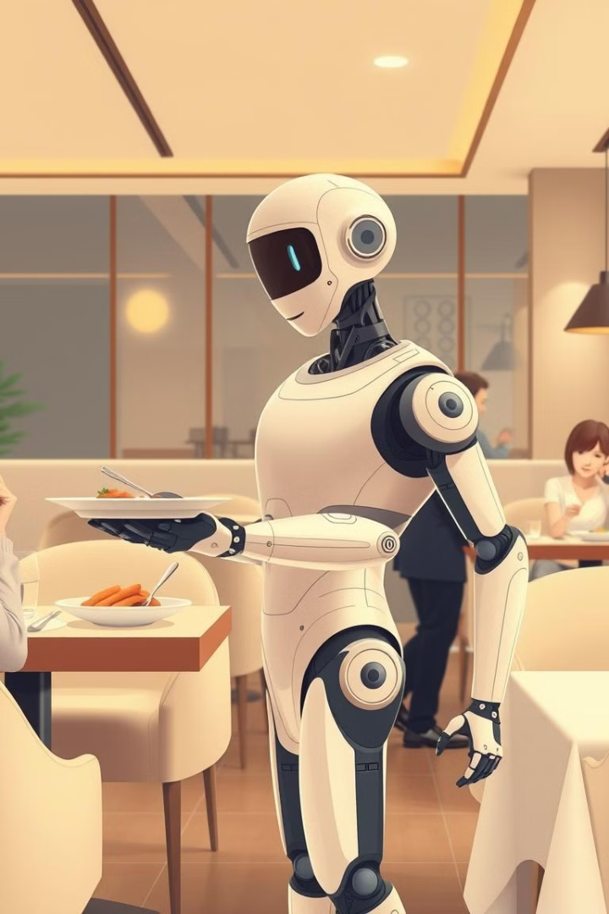
Introduction
Revolutionizing Hospitality: Autonomous robot waiters improve efficiency and customer satisfaction.
Key Focus Areas:
Implementation in modern service environments.
Benefits, challenges, and future trends.
Business Relevance: Crucial for staying competitive in a fast-evolving market.

Slide 4
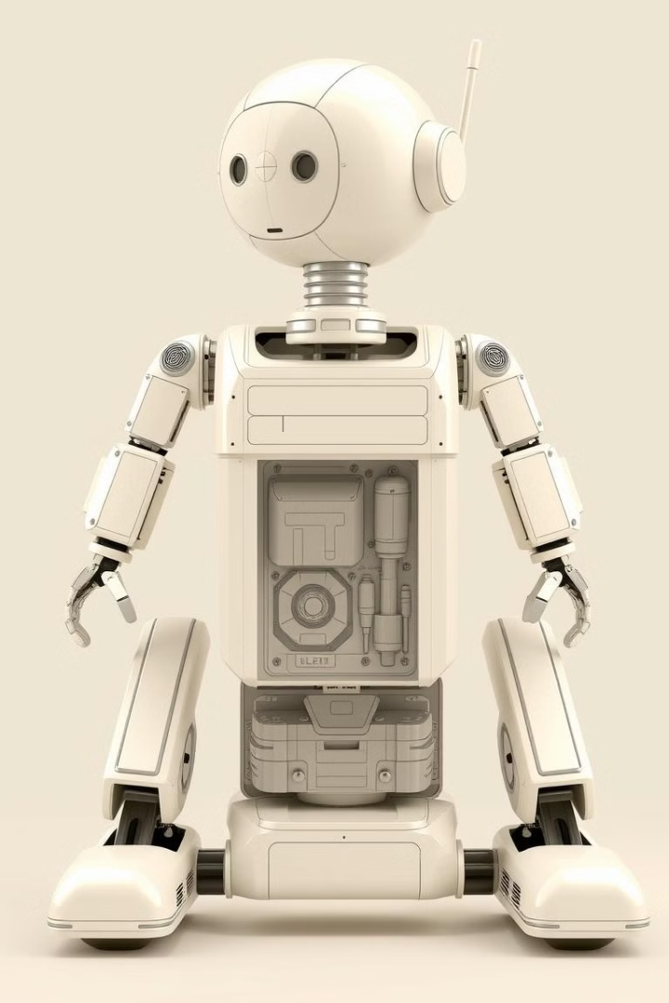
Technology Behind Robot Waiters
Advanced Systems
Customer Interaction
Adaptability
Continuous Improvement

Slide 5
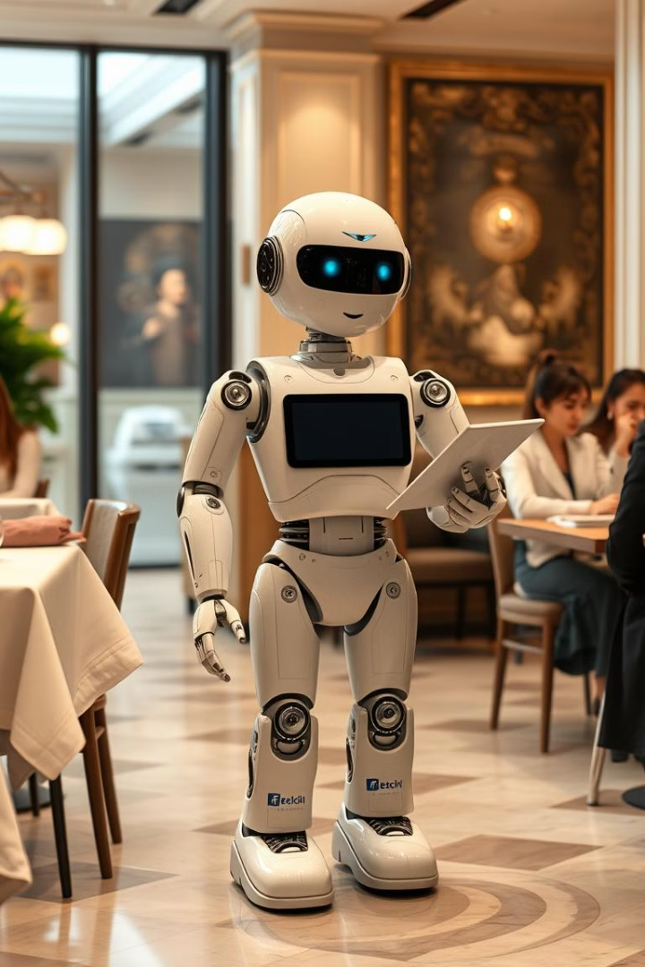
HARDWARE COMPONENTS
Robot Platform:
Chassis with motors and wheels.
Microcontroller:
ESP32 for movement control and Wi-Fi communication.
Motor Driver:
L298N or similar for motor control.
Power Supply:
Battery pack for robot operation.
camera
High-resolution camera for reliable tracking.

Slide 6
Software Development
Arduino IDE for ESP32 programming
python library for image recognition
wokwi for simulations and testing

Slide 7
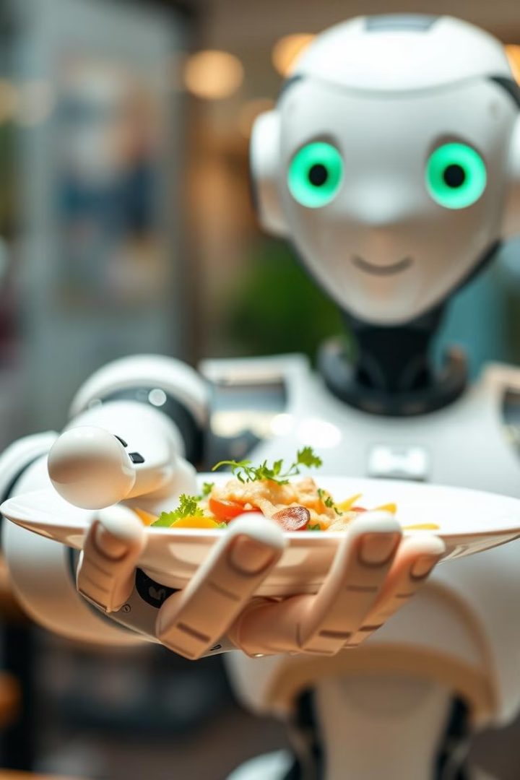
DESIGN & CIRCUIT
Robot Waiter: Delivers orders using advanced navigation capabilities
Centralized Camera: Monitors and guides the robot for precise navigation and object detection.
Automated Charging Station: Enables automatic recharging, minimizing downtime.
Tables with Unique IDs: Arcuro-coded tables ensure accurate order delivery.

Slide 8
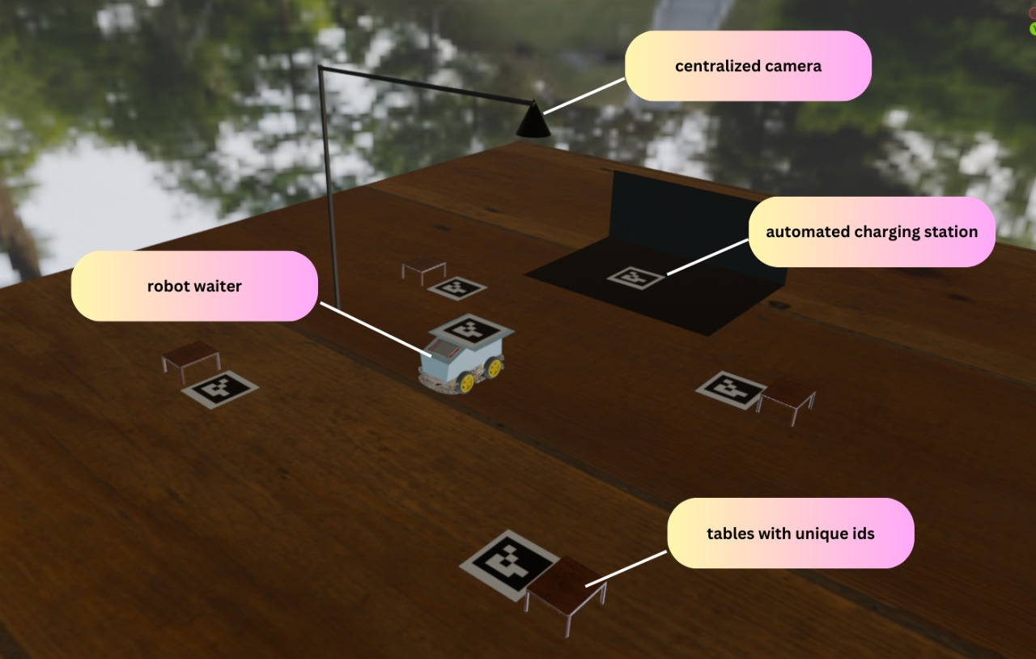
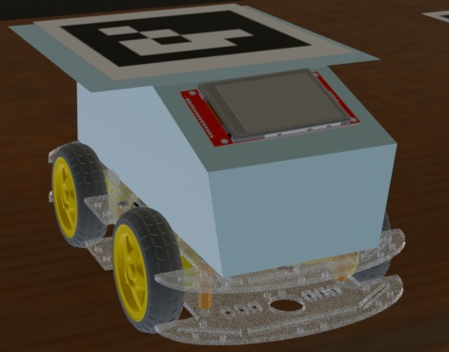
DESIGN & CIRCUIT
System
3D design

Slide 9
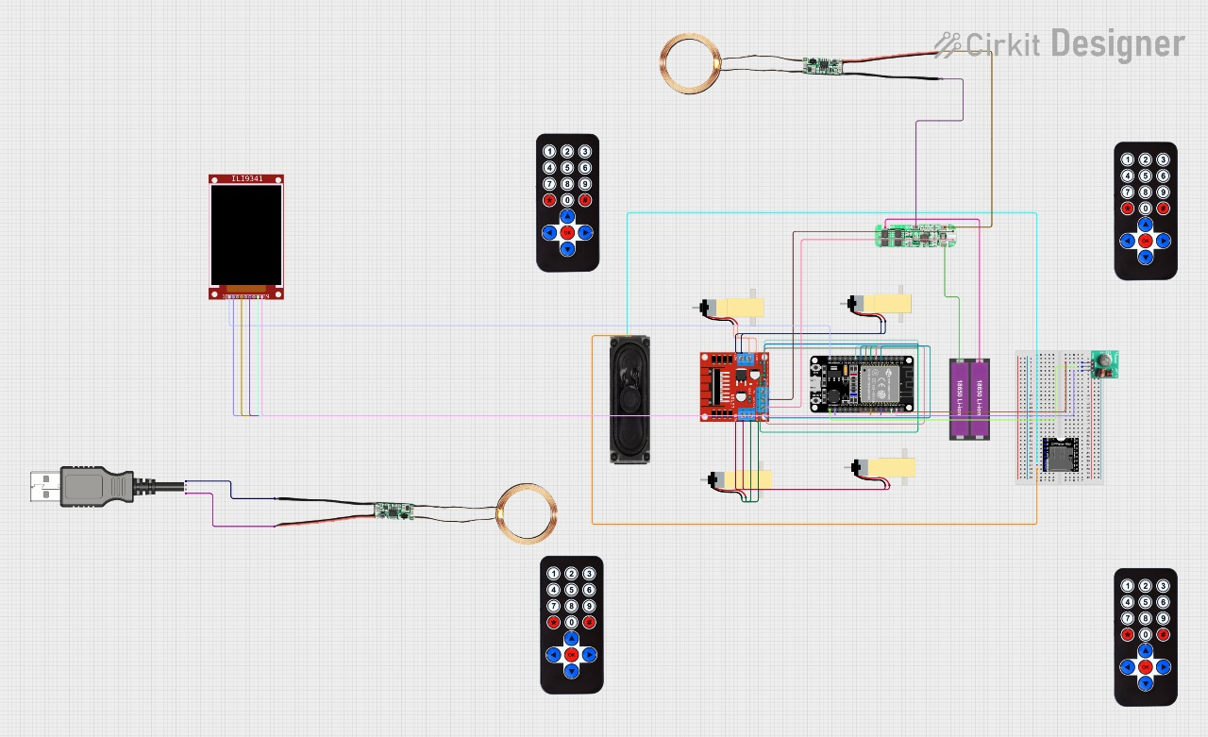
DESIGN & CIRCUIT

Slide 10
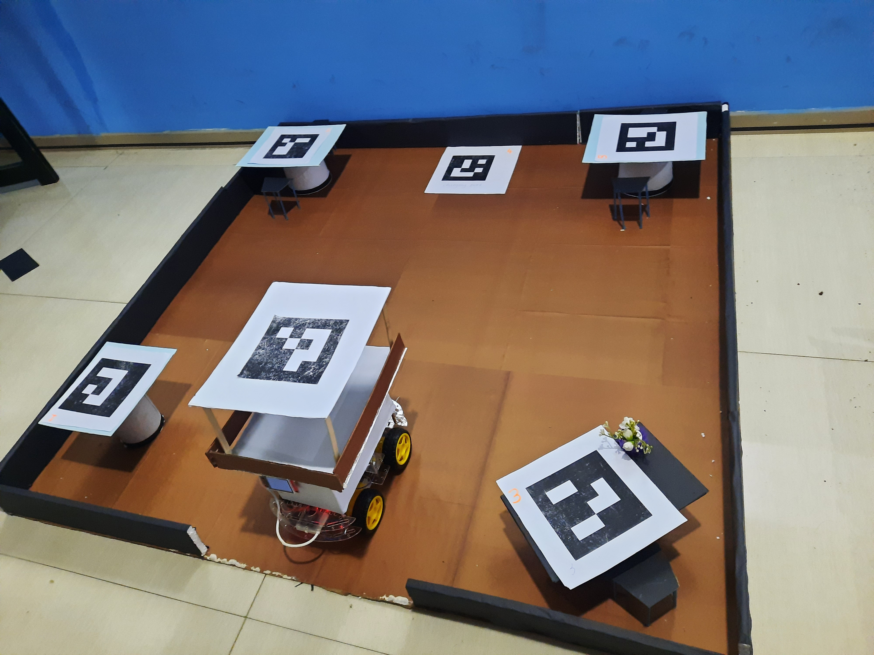
OUR FINAL DESIGN

Slide 11
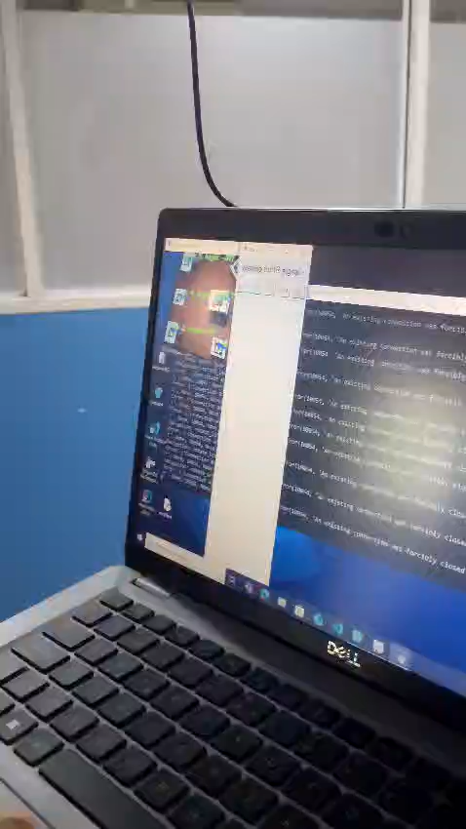
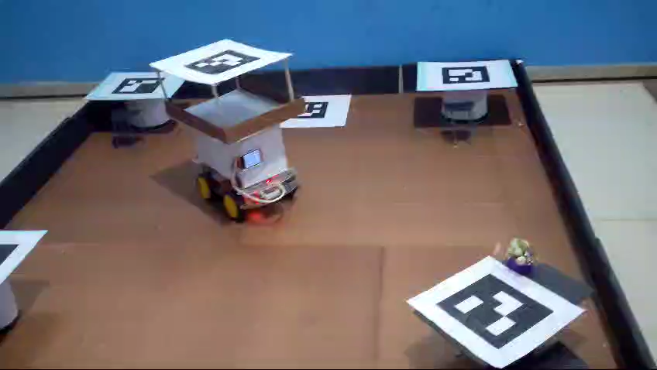
OUR FINAL DESIGN

Slide 12
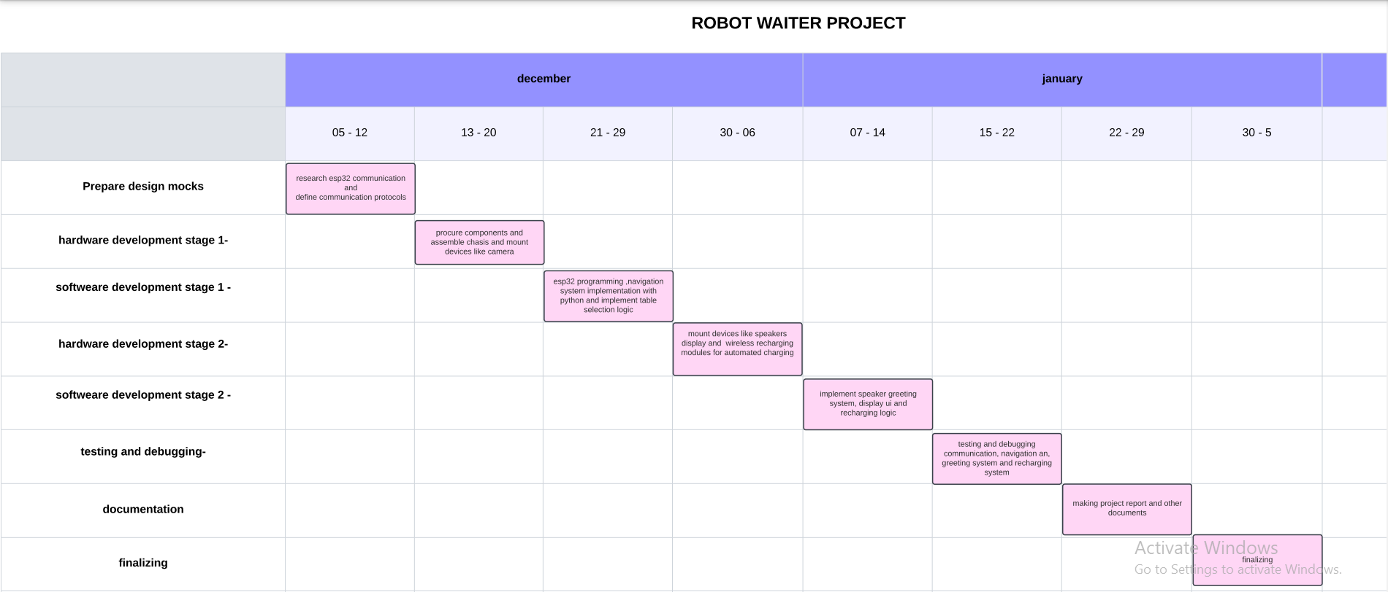
Updated GANTT Chart

Slide 13
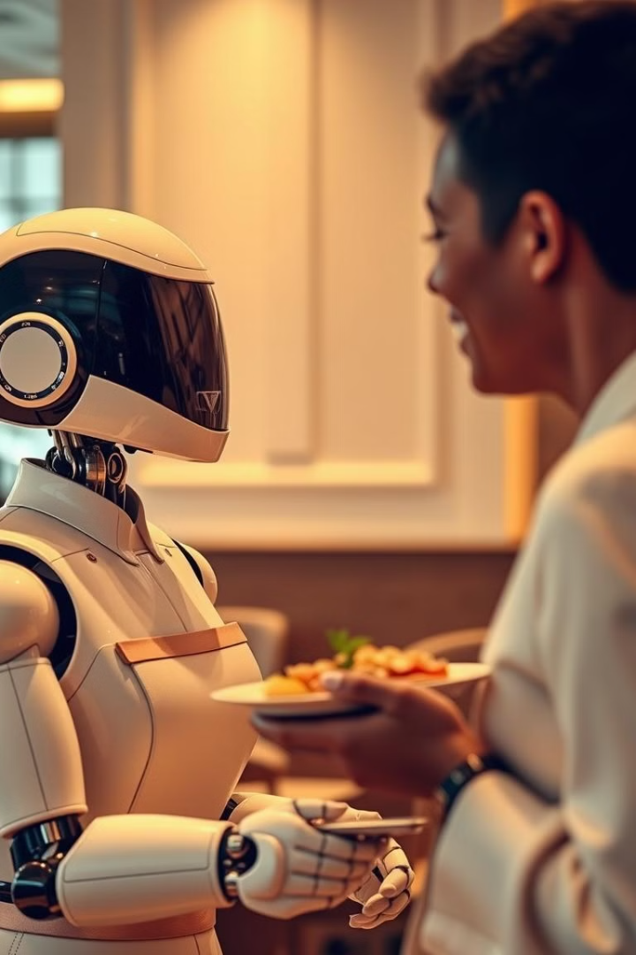
Conclusion
The implementation of autonomous robot waiters signiﬁes a pivotal shift in the hospitality sector. By embracing this technology, businesses can enhance service quality, reduce costs, and meet the evolving expectations of customers. The future is bright for those willing to innovate and adapt.

Slide 14
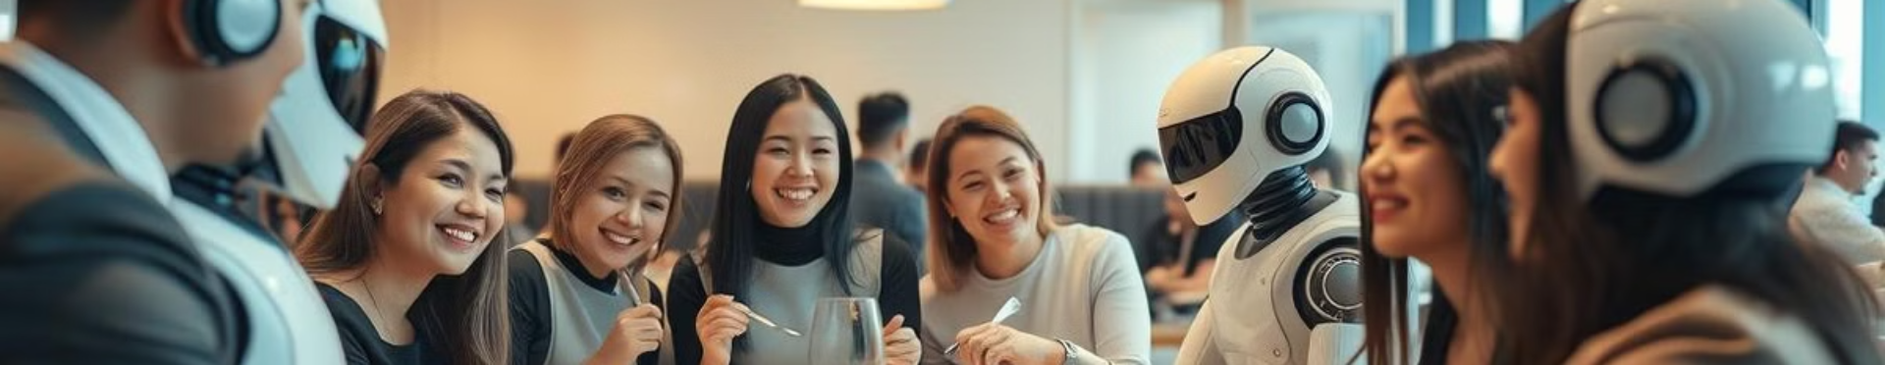
Thank you!

